Slide 1
CS410 – Text Information SYSTEMS PROJECT - Video table of content
By
Nitish Kumar Jain (nitishj2@illinois.edu)
Vibhor Jain (vibhorj2@illinois.edu)

Slide 2


Treat Video like Document
Just like books have table of contents and can be easily navigated, the vision was to bring this concept to videos.

Slide 3
Steps
Video Upload and Transcription
Setting up Flask Front end environment and Upload page
Applying Azure Cognitive Services API to do Speech to Text conversion
Section Partitioning
Preprocessing text
Use Glove Word Embedding Vectors for semantic meaning of sentences
Use Cognitive Services API to get timestamps for each beginning sentence of section

Slide 4
Steps Contd…
Display Table of Contents
Get title phrase for each section, using an extraction-based method
Display section timestamps and titles on Flask web page

Slide 5
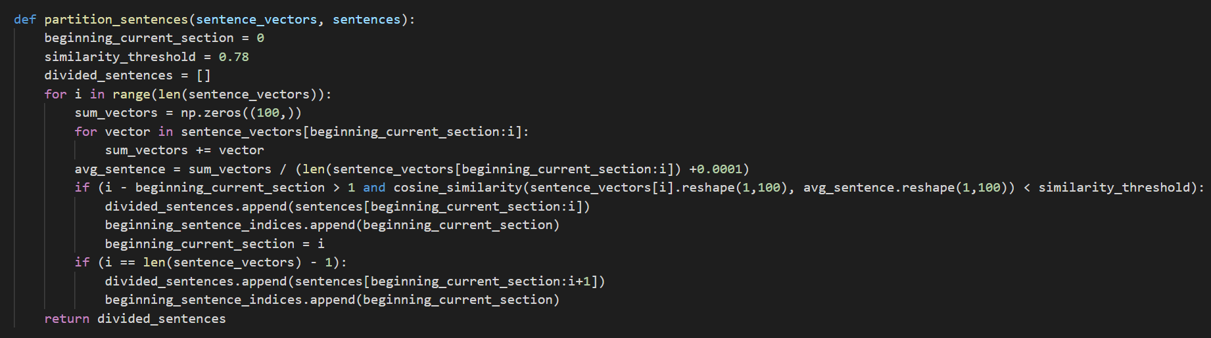
Section partitioning process

Slide 6
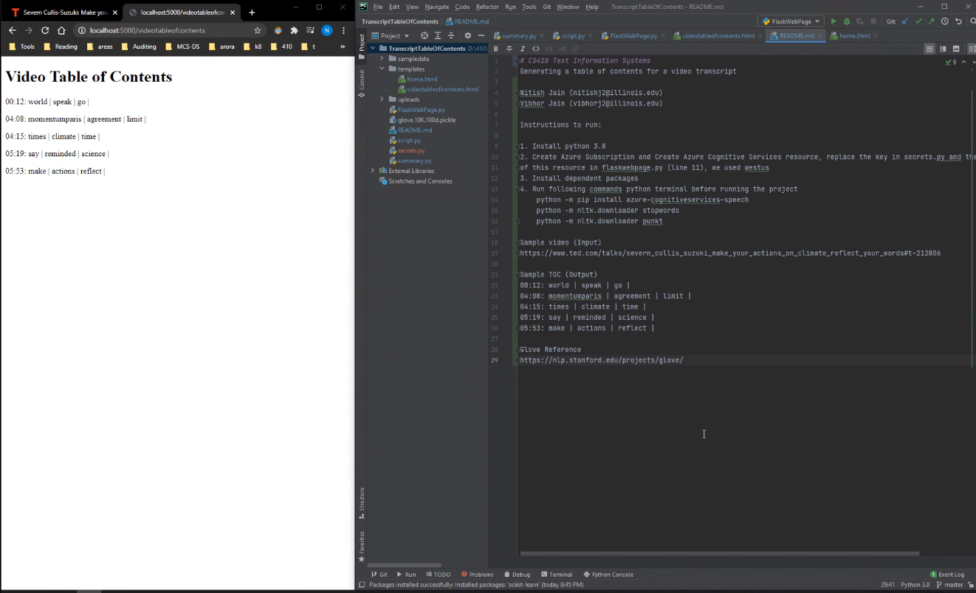
Sample run

Slide 7
Future improvements
Video transcription is a time taking process – this can be a separate process
Could remove semantically useless words for section title extraction
Could explore a generative approach for getting section titles

